Slide 1
Intelligent Character Reader (ICR) using Artificial Neural Networks (ANN)
Notes:
Payal starts

Slide 2
Presented By :
Dipayan Deb (13000113032)
Drona Banerjee (13000113033)
Karan Jaiswal (13000113039)
Payal Kumari (13000113060)
Under the guidance of:: Mrs. Poulami Dutta
(In-charge and Asst. Prof, CSE Dept)

Slide 3
Content
👉 Introduction
👉 Uses
👉 DFD
👉 Activity Diagram
👉 Use Case Diagram
👉 Segmentation
👉 Sliding Window Detection
👉Text Detection
👉 Image Processing
👉 Classification of cropped image
👉 Cost Estimation
👉 App Snapshots
👉 Future Scope
👉 References
:

Slide 4
INTRODUCTION
electronic conversion of images of a text to the characters.
edit and search the words in the scanned documents like paper and PDF files, images

Slide 5
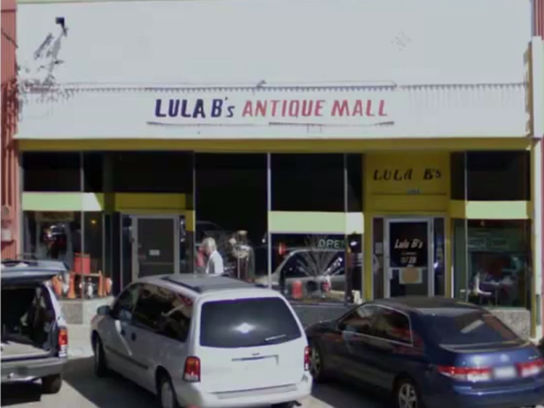
LULA B’s ANTIQUE MALL
LULA B’s
1
OPEN
LULA B’s

Slide 6
Uses :
Used as a form of data entry from printed documents
Eg: Passport documents, Bank statements, invoices, etc.
Vehicle license plate identification
Can be used to read foreign printed languages
Can be used to arrange letters in post offices
Helps in digitizing printed document
Benefits: Search
Compact storage
Text Mining
Machine translation

Slide 7
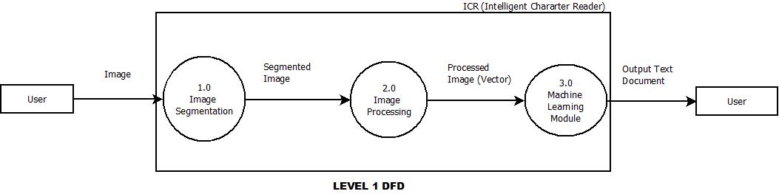
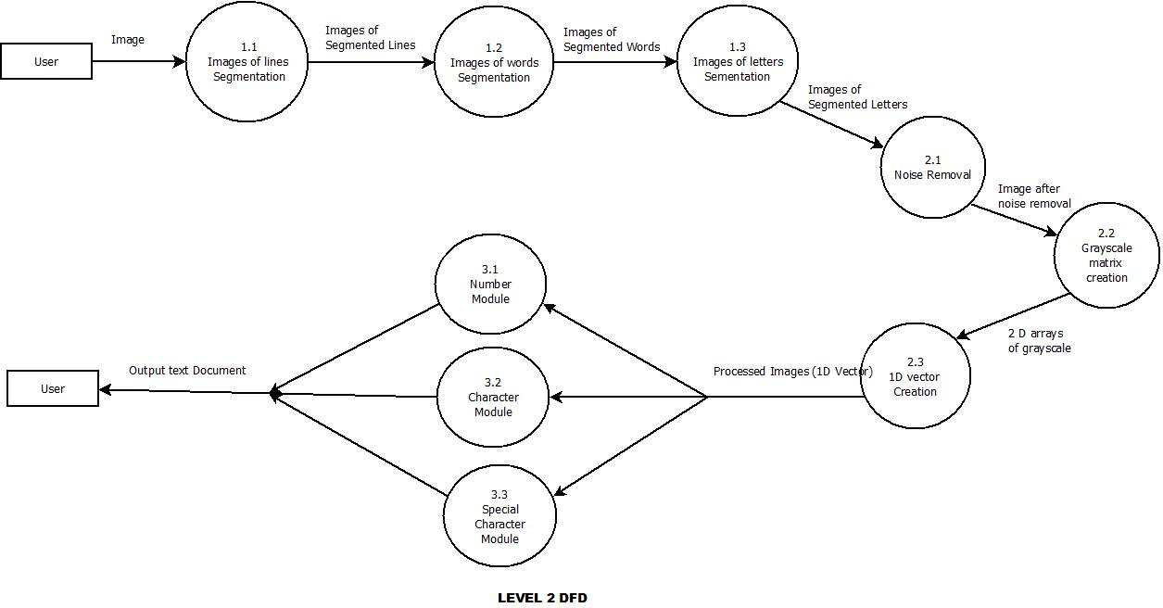
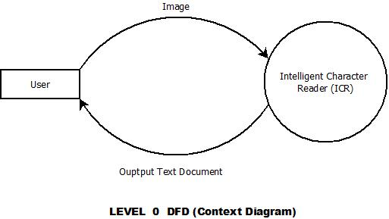
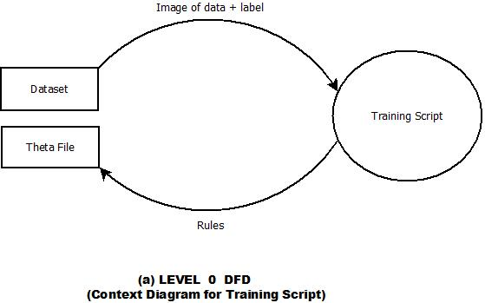
The Data Flow Diagram [DFD]

Slide 8
Images (e.g. )
Intelligent Character
Reader (ICR)
User
Output Text Document
(e.g. 1)
(a) Level 0 (Context Diagram)

Slide 9
Image
0.1
Image
Segmentation
Segmented
Image
0.2
Image
Processing
0.3
Machine Learning Module
1D Vector
(Processed Image)
Output Text
Document
(b) Level 1 DFD

Slide 10
Image
0.1.1
Images of
Segmented lines
0.1.2
Images of
Segmented
words
Segmented image
(words)
Segmented image
(lines)
0.1.3
Images of
Segmented
letters
Segmented image
(letters)
(c) Level 2 DFD

Slide 11
Segmented Images
(letters)
0.2.1
Noise
Removal
Noise free
(image)
0.2.2
Grayscale
Matrix
Creation
2D arrays of
grayscale
0.2.3
1D Vector
Creation
1D vectors
(Processed Images)
(c) Level 2 DFD

Slide 12
0.3.1
Number
Module
Output Text
Document
1D vectors
(Processed images)
0.3.2
Character
Module
0.3.3
Special
Character
Module
(c) Level 2 DFD

Slide 13
Data Image + Label Image
Training Script
Dataset
Theta File
Rules
(a) Level 0
(Context Diagram for Transcript Script)

Slide 14
Input Image
Error
Segmentation
Image format not supported
Image format supported
Feature extraction
Image Processing
Recognition
Activity Diagram
Output generation

Slide 15
Input Image
Conversion of image to gray scale
Initialize
user
<<include>>
process image
Gray scale to binary format conversion
<<include>>
Segmentation
<<include>>
system
Normalization
Recognition
Output generation
Use Case Diagram

Slide 16
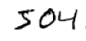
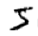
Segmentation Process :
Images
Of
Lines
Images
Of
Words
Images
Of
Characters

Slide 17
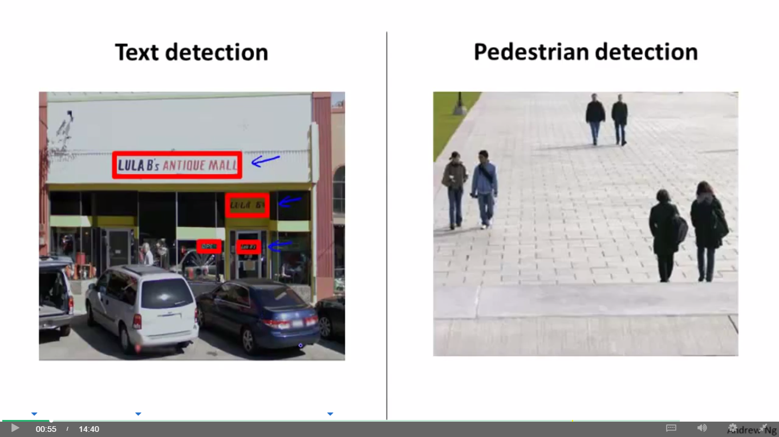
89,526,124
Sliding Window :
Text detection
Pedestrian detection
Notes:
Dips starts

Slide 18
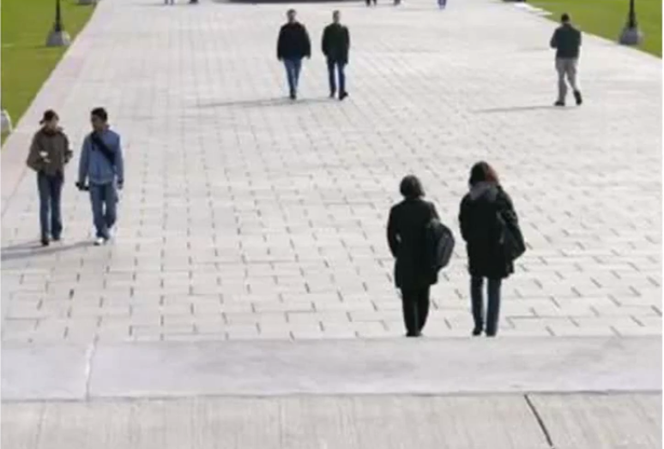
Sliding Window Detection
stride

Slide 19
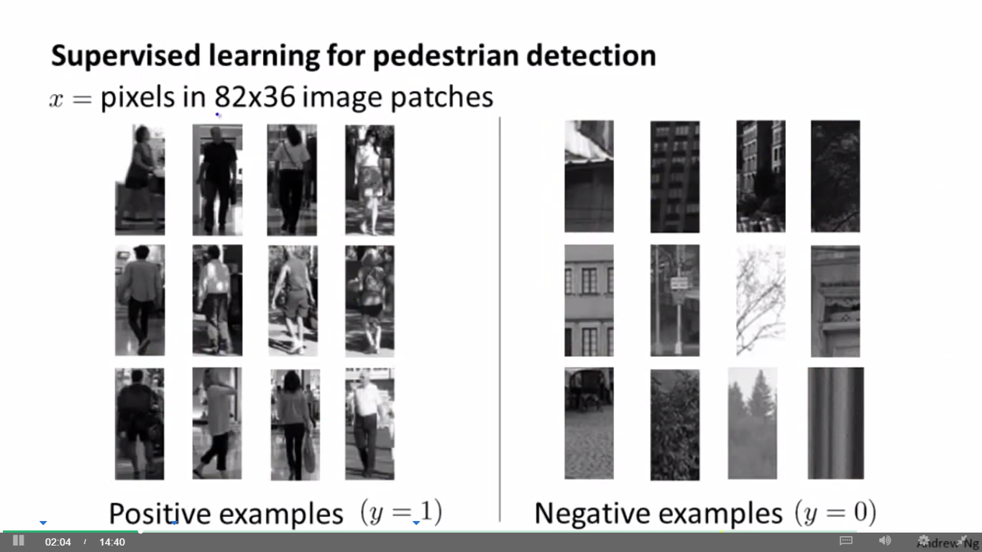
Supervised learning for pedestrian detection
X = pixels in 82 x 36 image patches
Positive examples y =1
Negative examples y =0

Slide 20
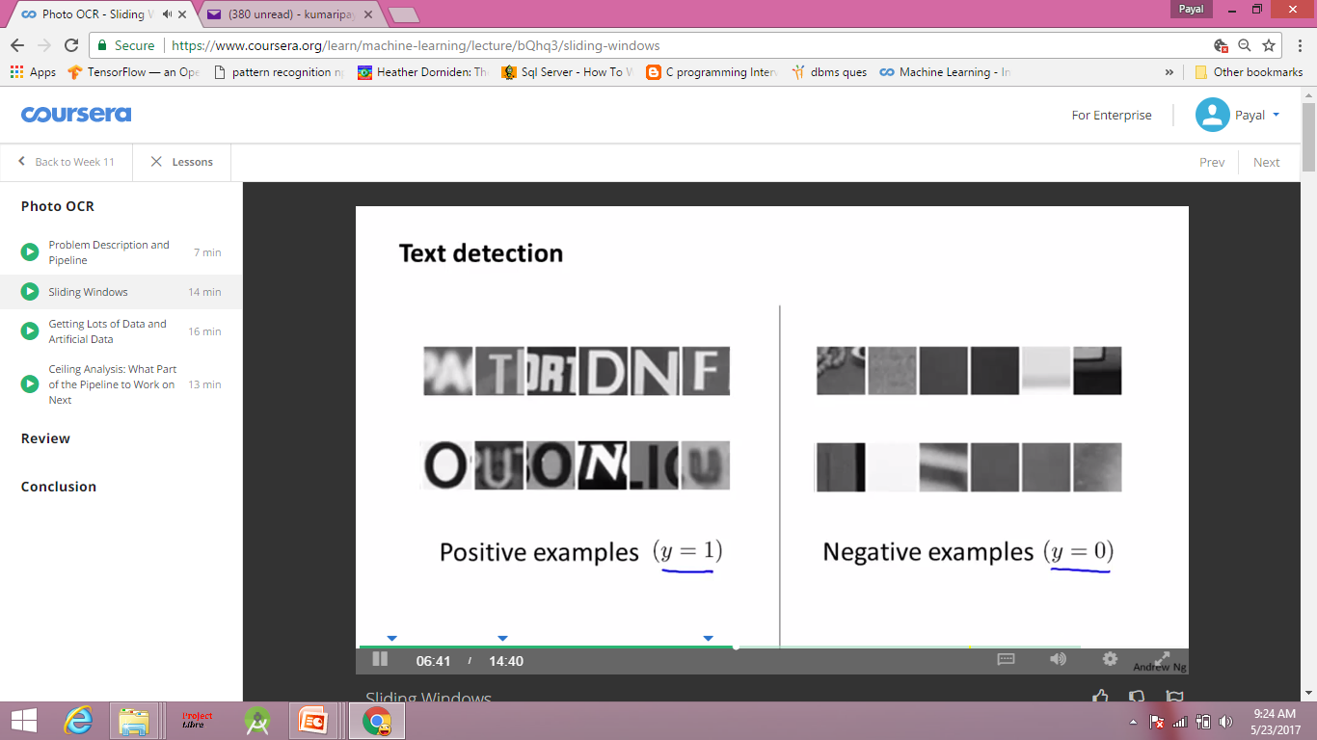
Text detection
Positive examples y =1
Negative examples y =0

Slide 21
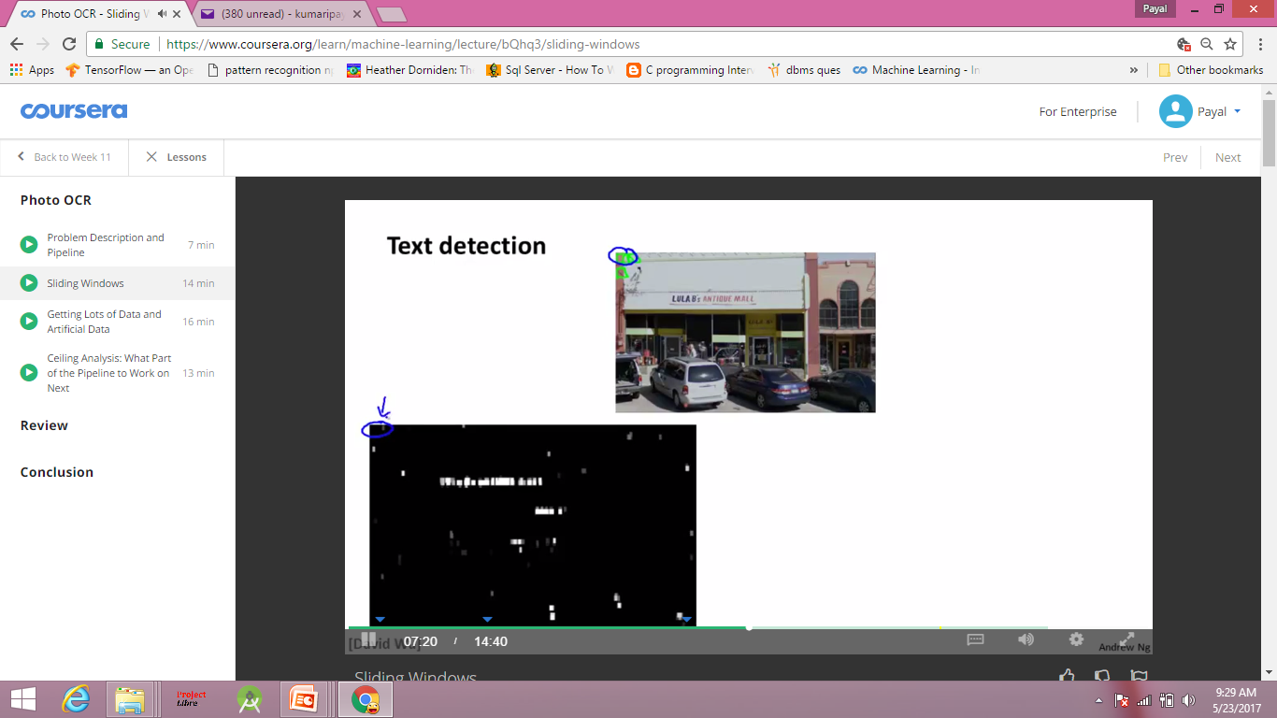
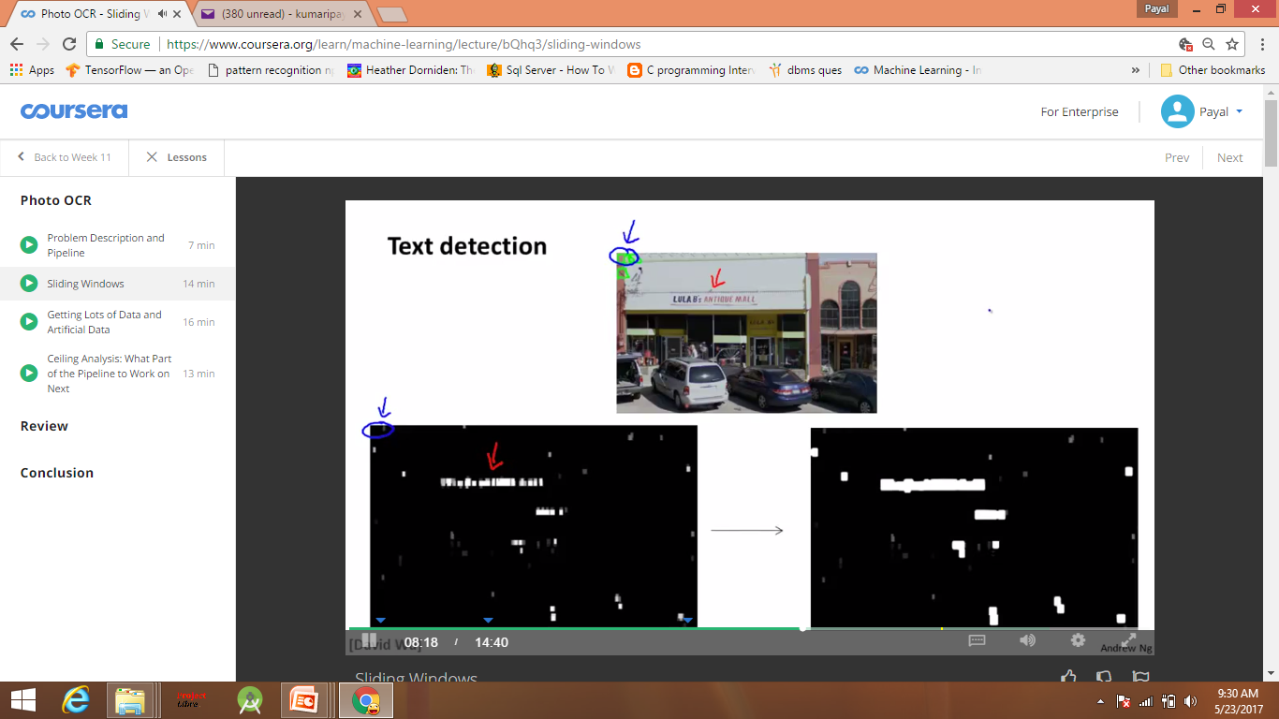
Text detection
expansion

Slide 22
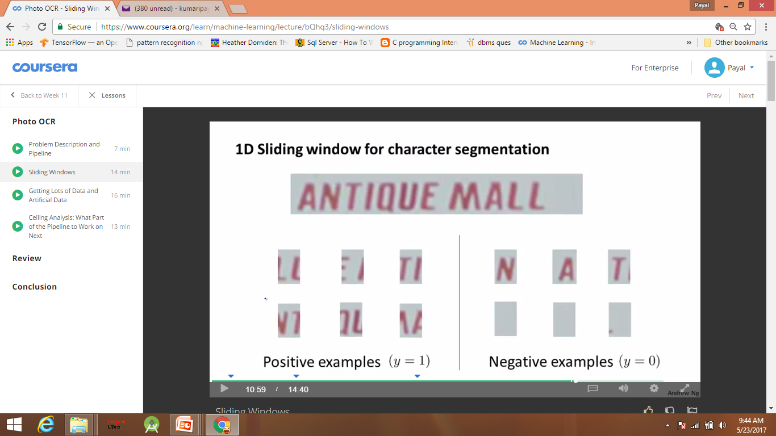
1 D sliding window for character segmentation
Positive examples y =1
Negative examples y =0

Slide 23
Image Processing :
Noise Removal
2D Grayscale Matrix
1D Vector Creation
3D RGB Matrix
Notes:
Drona Starts

Slide 24
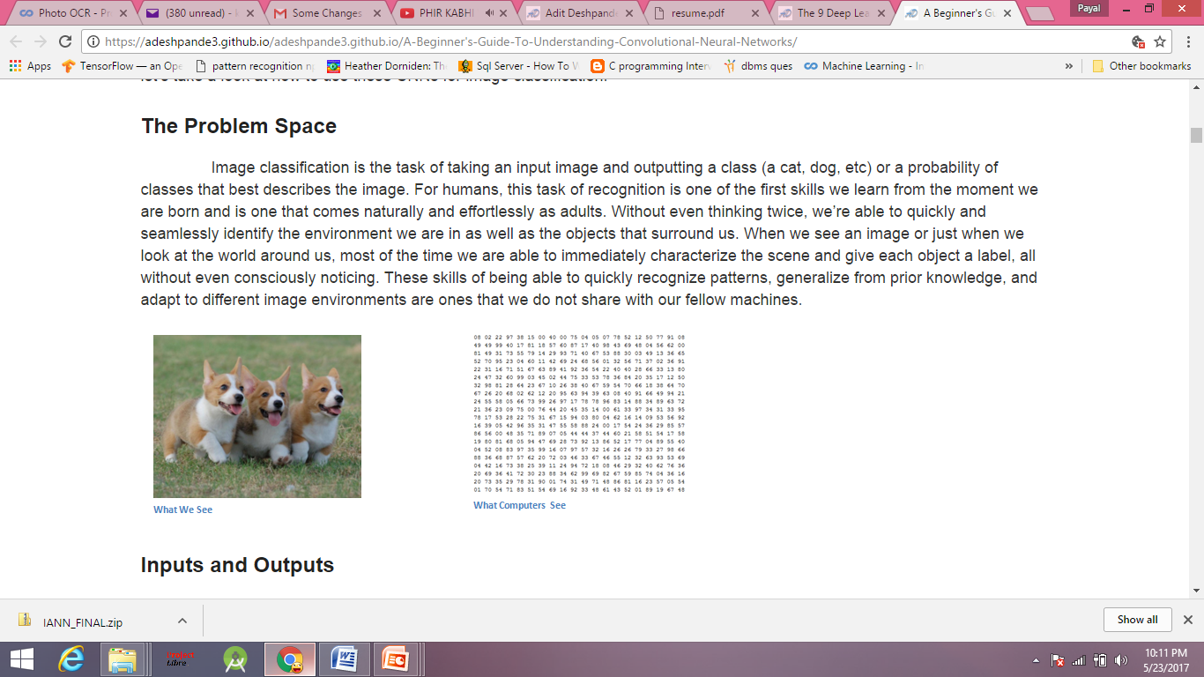
RGB Matrix
What we see
What does the computer sees
Now this gets converted into Grayscale Matrix.

Slide 25

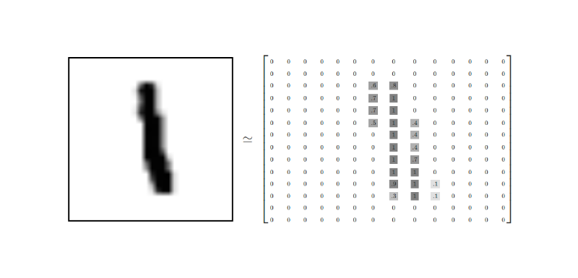
How does the computer know it’s a 1 ?

Slide 26
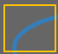
Original Image
Visualization of the filter
0 | 0 | 0 | 0 | 0 | 0 | 30
0 | 0 | 0 | 0 | 50 | 50 | 50
0 | 0 | 0 | 20 | 50 | 0 | 0
0 | 0 | 0 | 50 | 50 | 0 | 0
0 | 0 | 0 | 50 | 50 | 0 | 0
0 | 0 | 0 | 50 | 50 | 0 | 0
0 | 0 | 0 | 50 | 50 | 0 | 0
0 | 0 | 0 | 0 | 0 | 30 | 0
0 | 0 | 0 | 0 | 30 | 0 | 0
0 | 0 | 0 | 30 | 0 | 0 | 0
0 | 0 | 0 | 30 | 0 | 0 | 0
0 | 0 | 0 | 30 | 0 | 0 | 0
0 | 0 | 0 | 30 | 0 | 0 | 0
0 | 0 | 0 | 0 | 0 | 0 | 0
*
Visualization of the receptive field
Pixel representation of the receptive field
Pixel representation of the filter
Multiplication and Summation= (50*30)+(50*30)+(50*30)+(20*30)+(50*30) = 6600 (A large number!)

Slide 27
Classification of cropped images :
1. Neural Network is used to classify the Images.
2. The input layer has 784 input neuron.
3. The output layer has 82 output neurons..
28
28

Slide 28
A simple classification problem.
Neural Network Trained using Backpropagation.
Uses Sigmoid function as activation.
Use regularization for addressing overfitting or high bias.
Four Layer Neural Network
0
0
0
1
0
.
.
.
0
.
.
0
1
2
3
4
.
.
.
a
.
.

Slide 29
Cost Estimation :
Model used : COCOMO model (Semi Detached)
Estmated KLOC = 2.7
A1 = 3.0 a2 = 1.12 b1=2.5 b2=0.35
Effort = 3.0 * (2.7)^1.12 PM
= 9.13 PM
Tdev = 2.5 * (9.13) ^0.35 Months
= 5.42 Months
Team Size = 4 Assumed labour cost = Rs 10000 per month per employee
Man power = Rs 216000
Materials Required
COST | QUANTITY | ITEM
5999.00 | 1 | Microsoft Office 2016 for Home and student
1900.00 | 1 | Windows 7 starter edition 32 bit

Slide 30
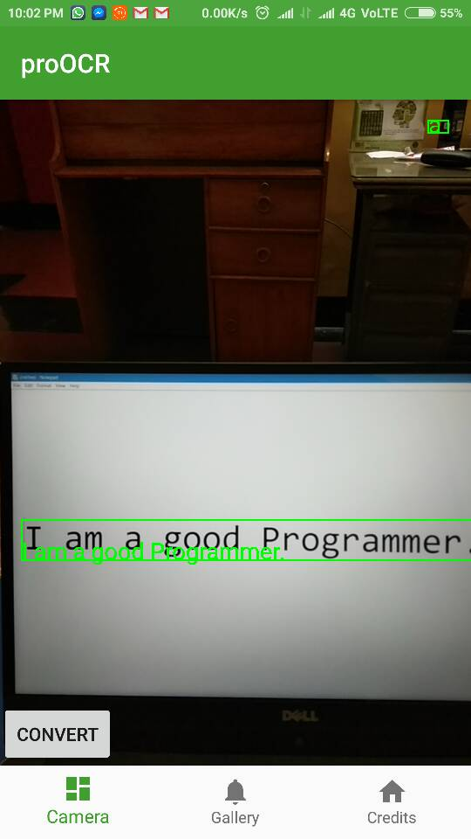
Place your screenshot here
How to use the app ?

Slide 31
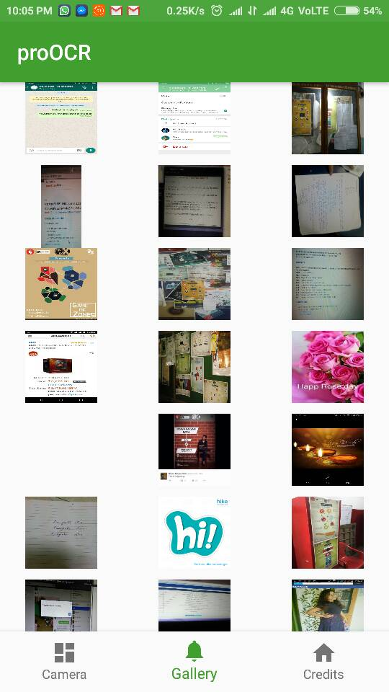
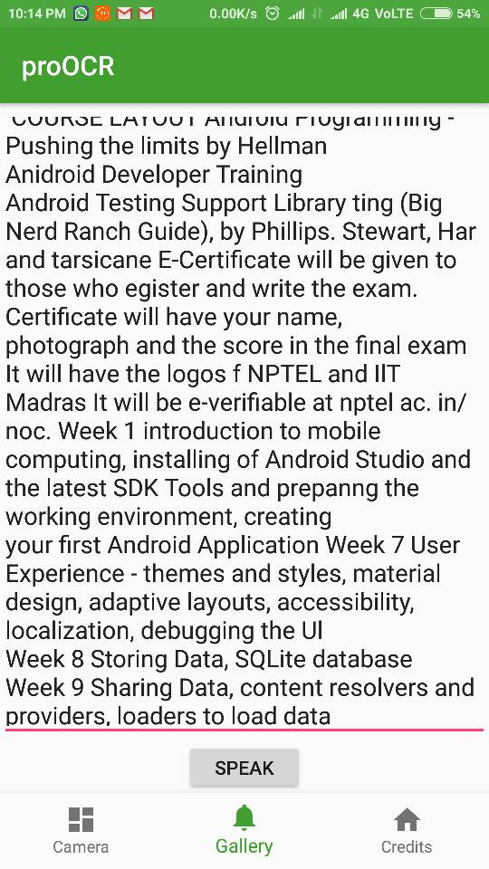

Slide 32
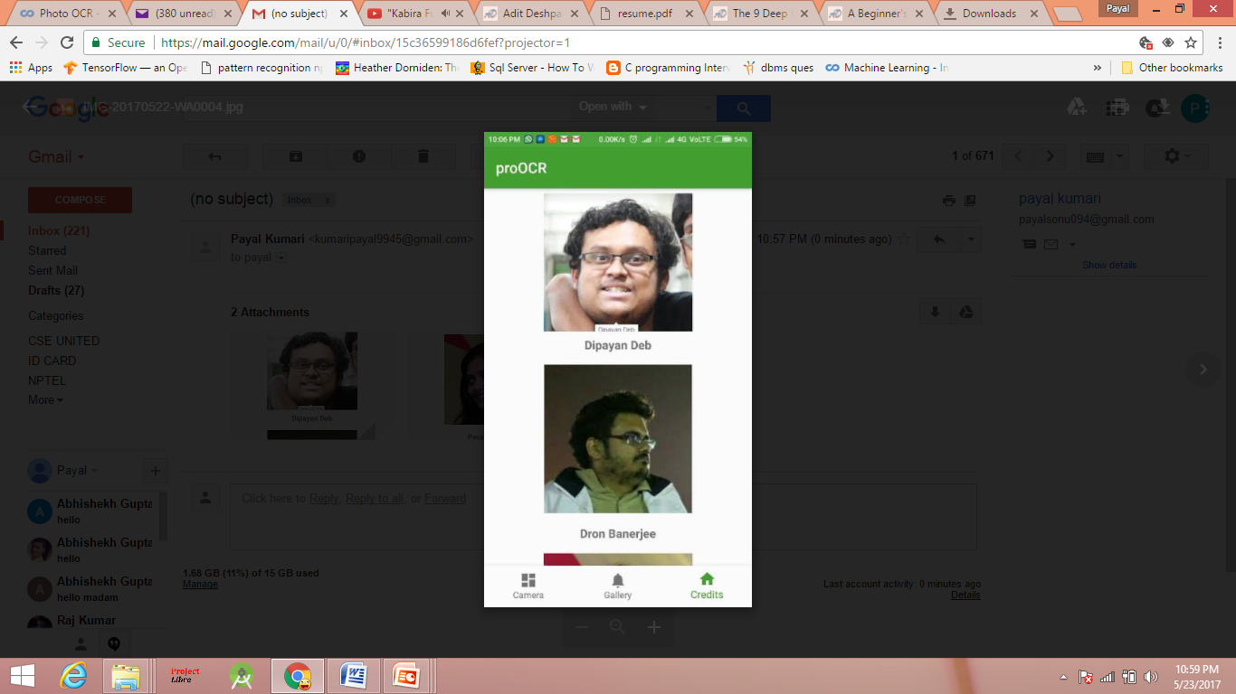
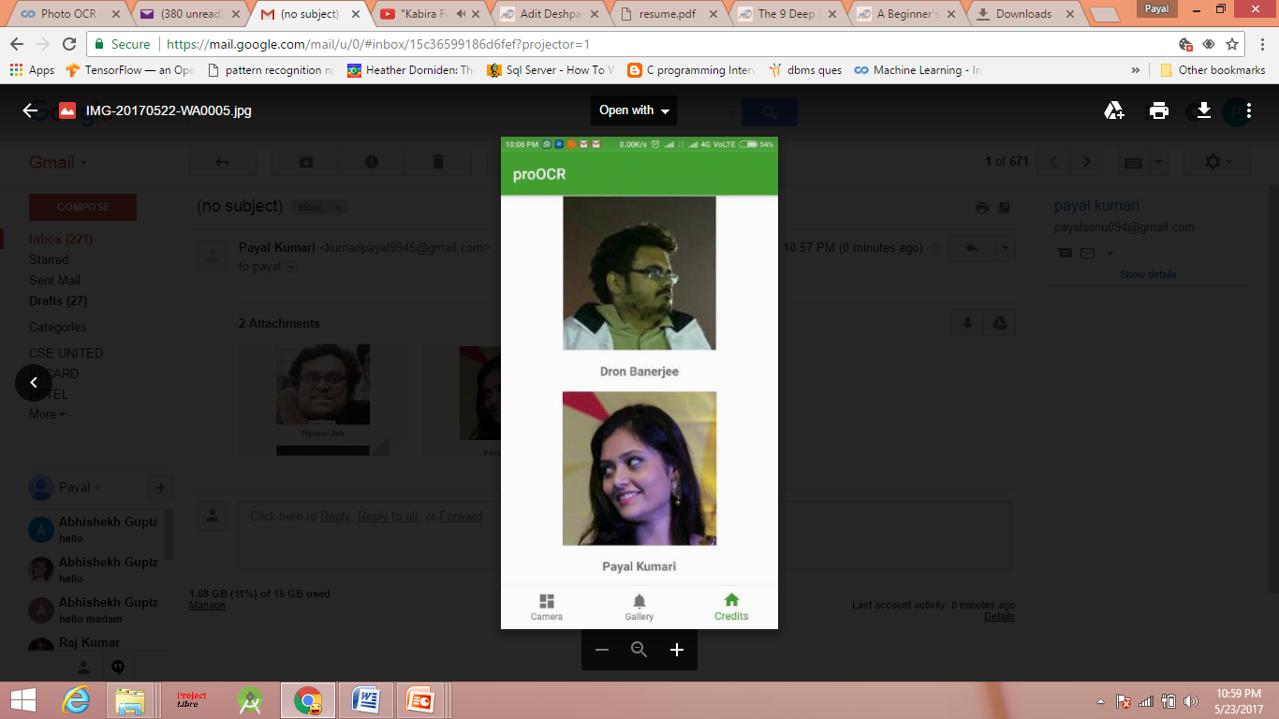

Slide 33
Future Scope of Improvement :
Intelligent Word Readers can be built that process one word at a time.
Interpreting the sentence on basis of prior knowledge and understanding can be implemented.
Using advanced Natural Language Processing.
Modules of any other language can be added.

Slide 34
References
https://www.coursera.org/learn/machine-learning
https://adeshpande3.github.io/adeshpande3.github.io/A-Beginner's-Guide-To-Understanding-Convolutional-Neural-Networks/
https://adeshpande3.github.io/adeshpande3.github.io/A-Beginner's-Guide-To-Understanding-Convolutional-Neural-Networks-Part-2/
Y. Le Cun, B. Boser, J.S. Denker, D. Henderson, R.E. Howard, W. Hubbard, L.D. Jackel, et al. Handwritten digit recognition with a back-propagation network. In Advances in neural information processing systems, 1990.

Slide 35
THANK YOU !

